Slide 1
International Day of the Girl Child 2023
“Digital generation. Our generation.”

Slide 2
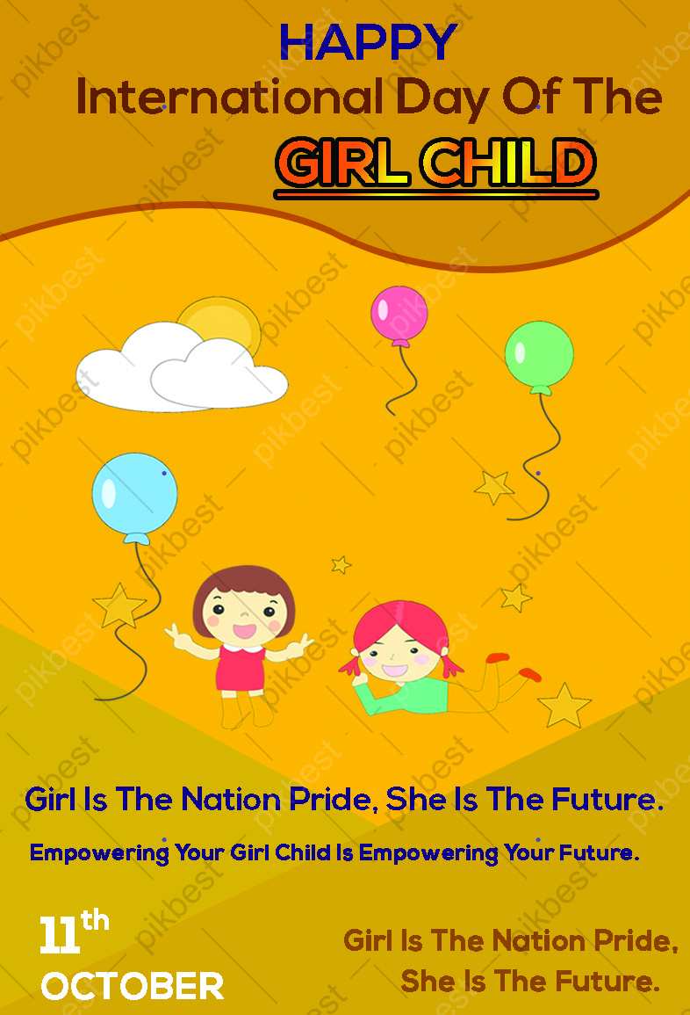
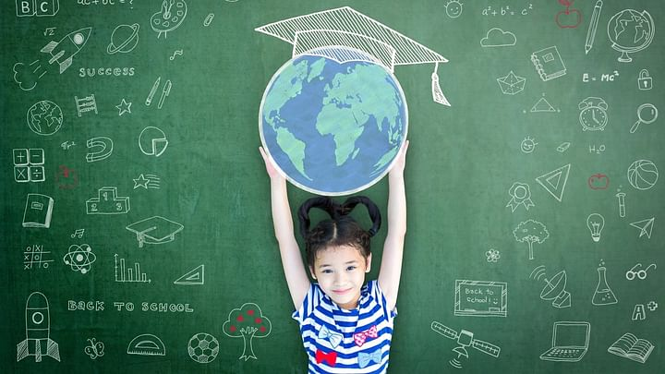
From the Kingdom of Lesotho
I am precious I am a girl child
I dream of a bright & beautiful future

Slide 3

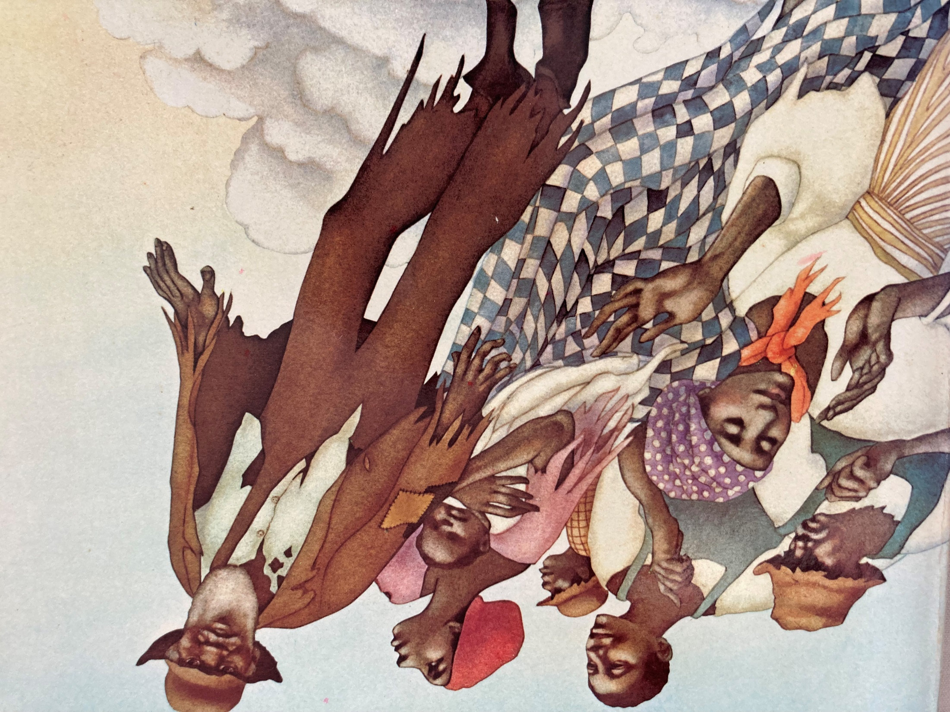
The People Could Fly
Illustration by Leo & Diane Dillon
Girls can SOAR just as…

Slide 4
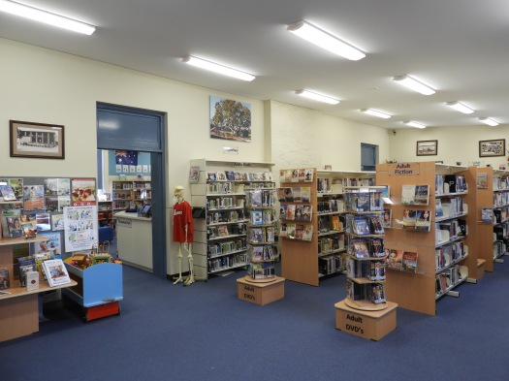
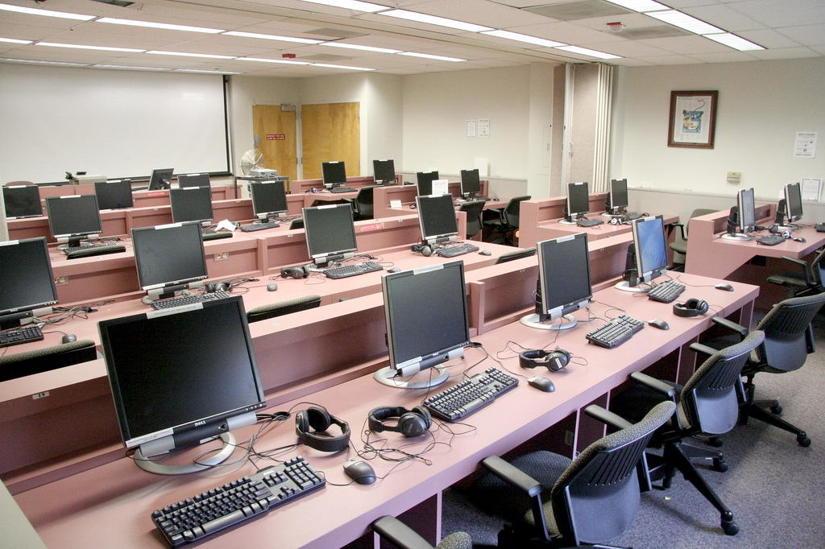
If we had a Library AND a Computer Laboratory, girls in our community could achieve their rights/practice their full rights

Slide 5
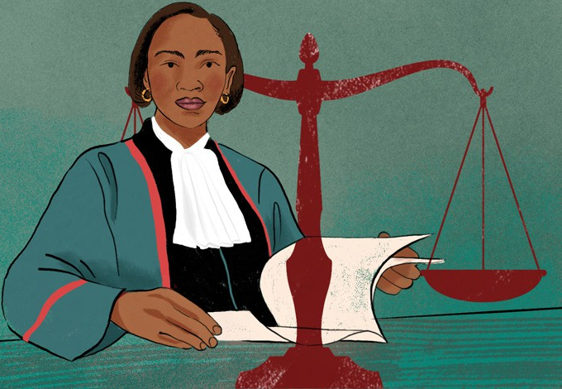
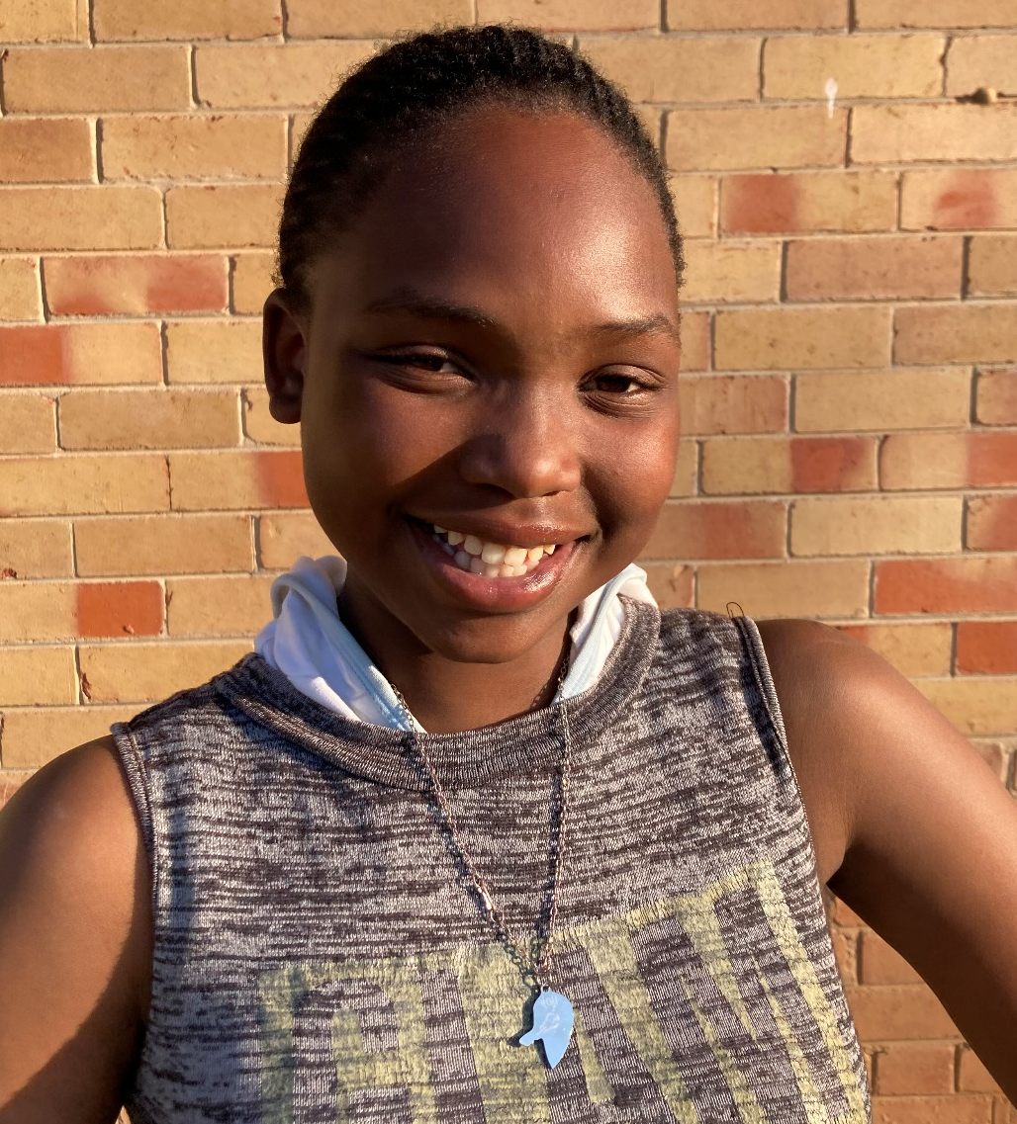
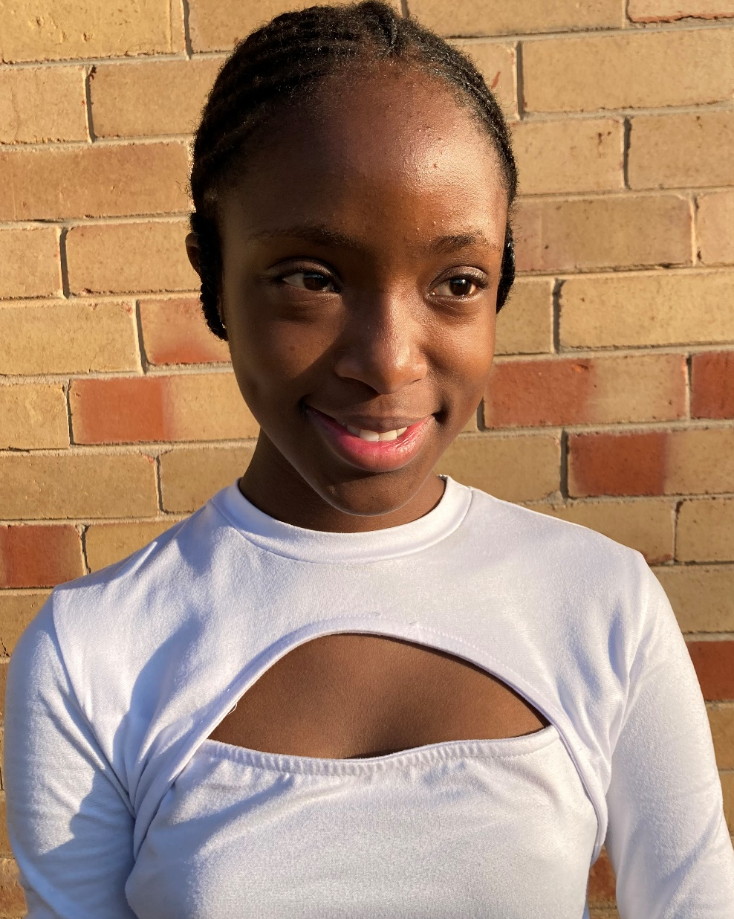
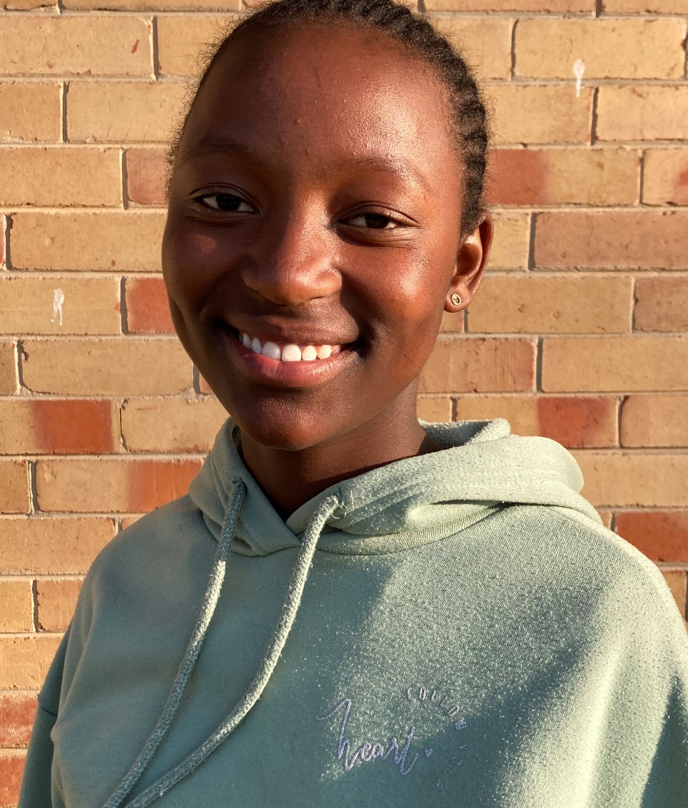
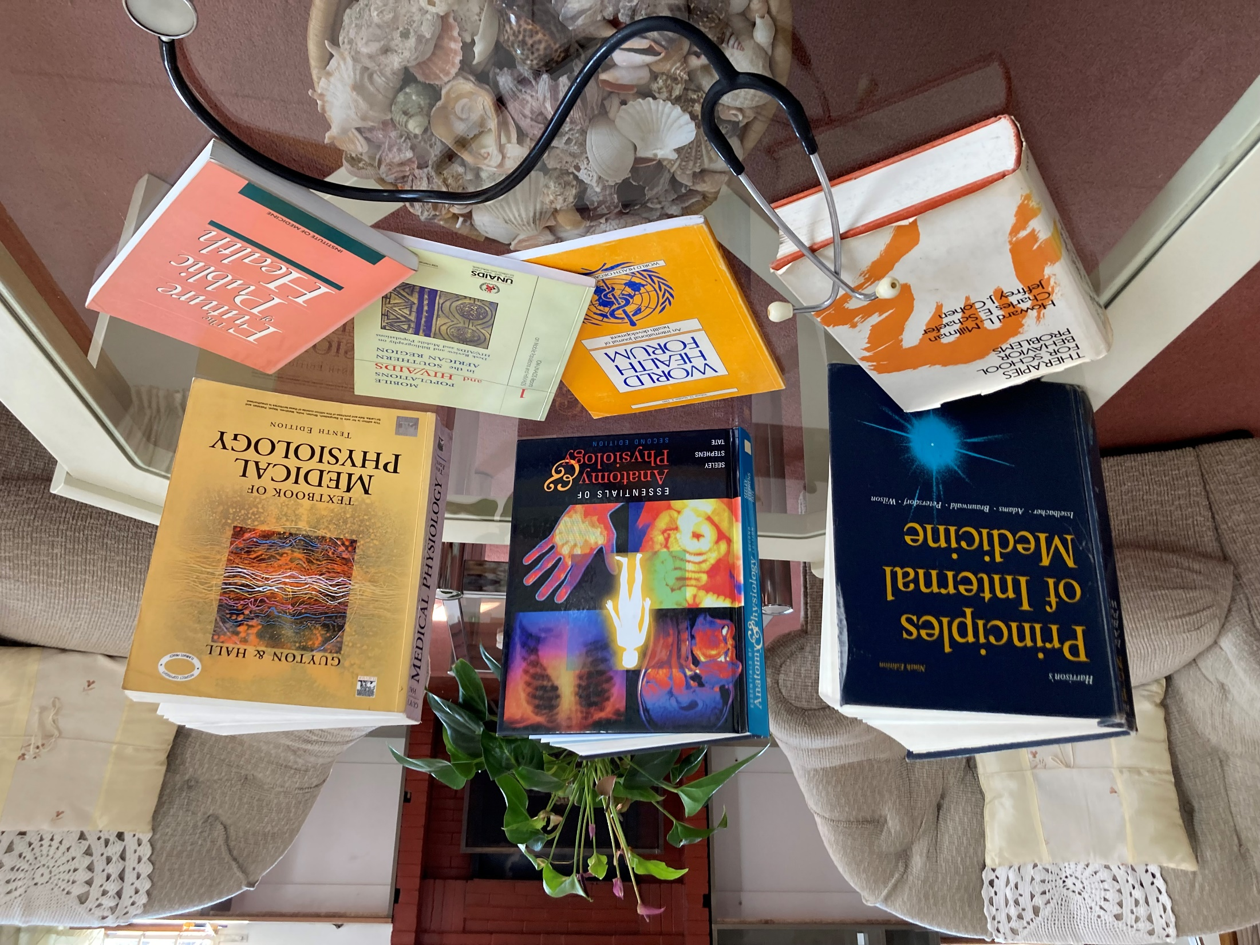

“I want to be a Divorce Lawyer because I really want to help couples have peace in their lives.”
Nthabeleng
We are driven
Thuto
“I want to be a Judge because I want to help innocent people. I don’t want to see people do illegal actions.”
We love education
Tanki
“I want to be a Doctor because I want to help people who are suffering/in pain.”

Slide 6
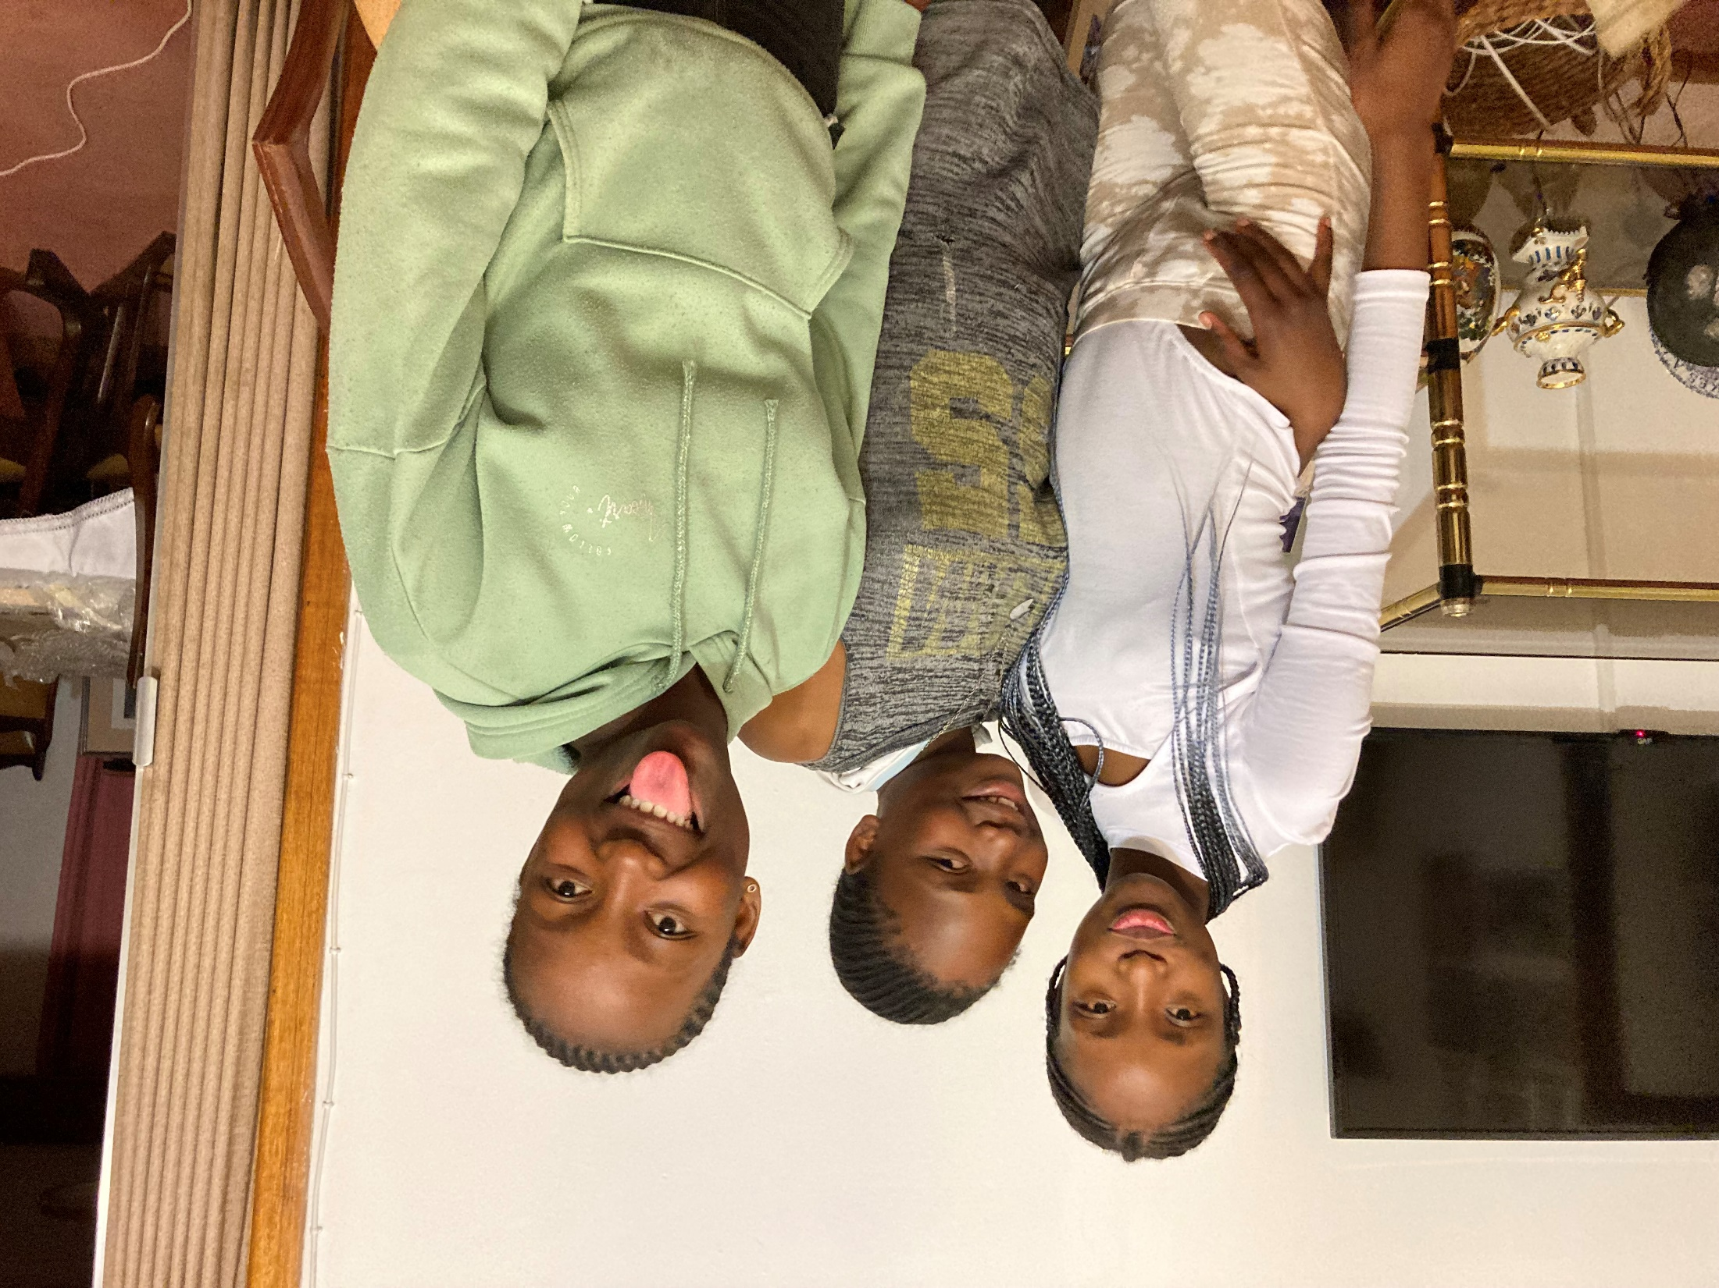
Allow me to choose my career
We are humans, not toys
We don’t want to be told what we should or can be
We are important beings
I don’t belong only in the kitchen
I can work on cars too…

Slide 7
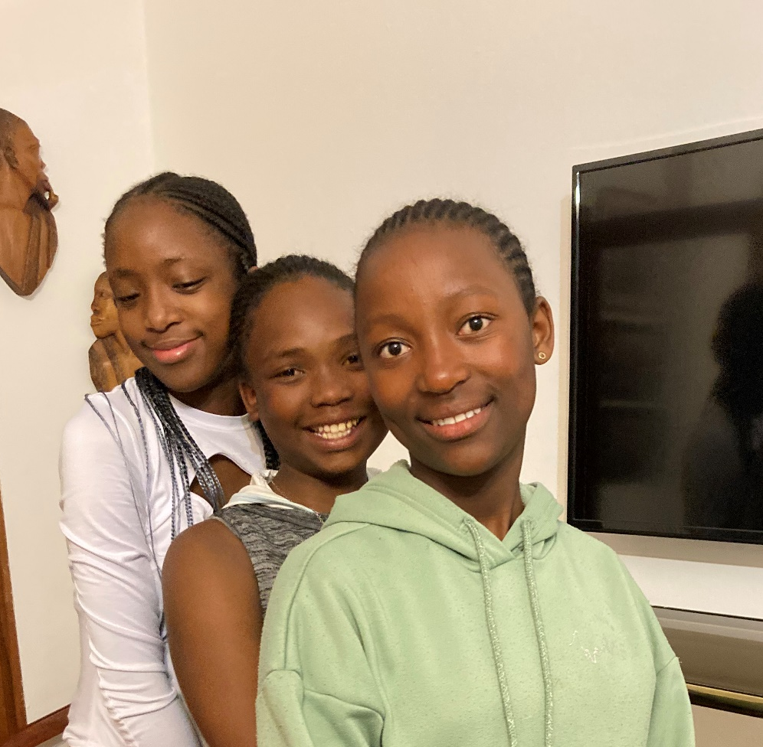
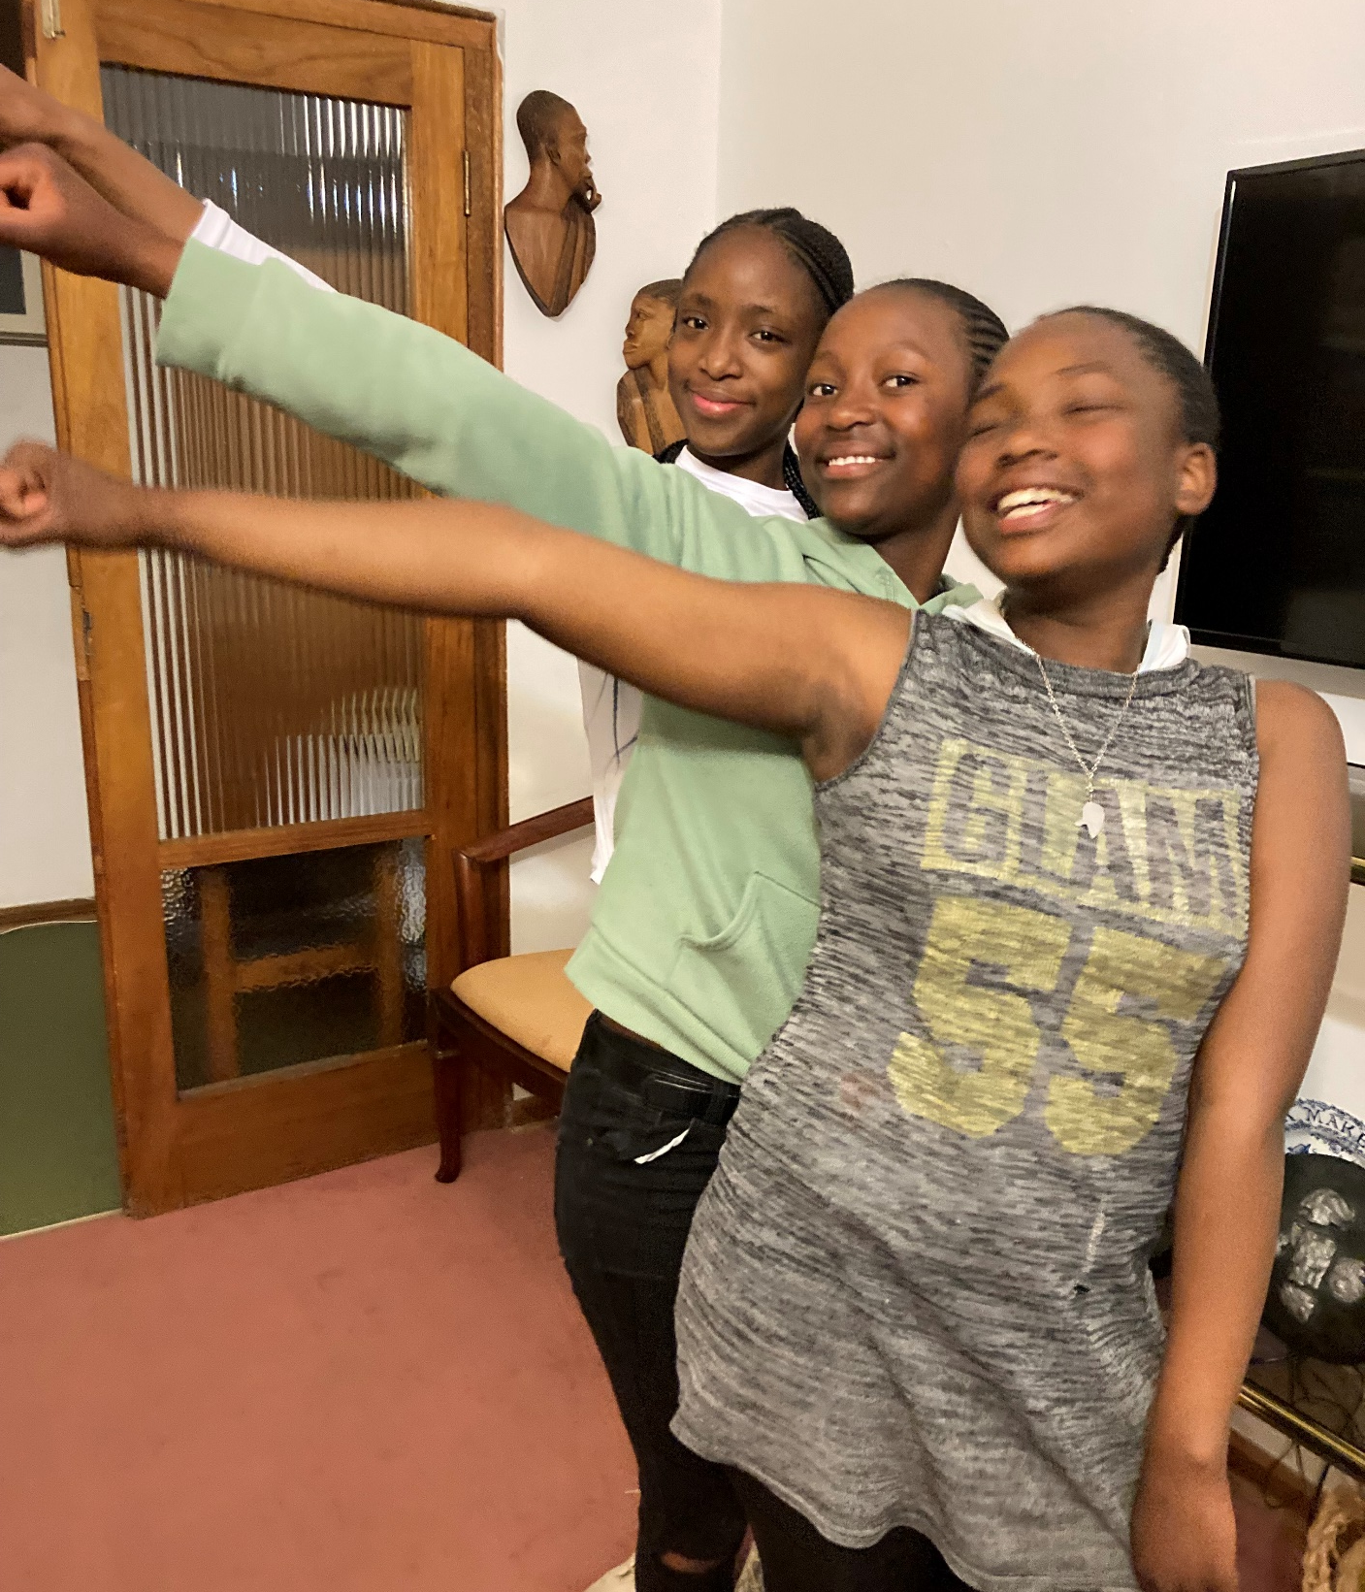
Trust me
I have rights
I am responsible
Thuto. Nthabeleng, Tanki
Girl Power
We know our rights

